Slide 1
Cleaning Data & Tabyls With janitor
Intro to Data Science Workshop Series Juan Quinones & Corbin Cerny

Slide 2

Hidden Talents, Huge Impact
The Example of will hunting
Data cleaning & preparation is tedious…but it is also essential
The Metaphor of Matt Damon as ‘Will Hunting’
janitor operating in the background, ensuring that data is in the best possible shape for analysis
Numbers Around Us – “Why Every Data Scientist Needs The janitor Package”

Slide 3
Never Underestimate the Janitor
Cleaning dirty data
examining dirty data
clean_names()
remove_empty() & remove_constant()
excel_numeric_to_date()
get_dupes()
tabyl()
adorn_()
“I just have a little question here. You could be a janitor anywhere. Why did work at the most prestigious technical college in the whole EXPLATIVE world?” – Robin Williams as Dr. Sean Maguireto, “Good Will Hunting”

Slide 4
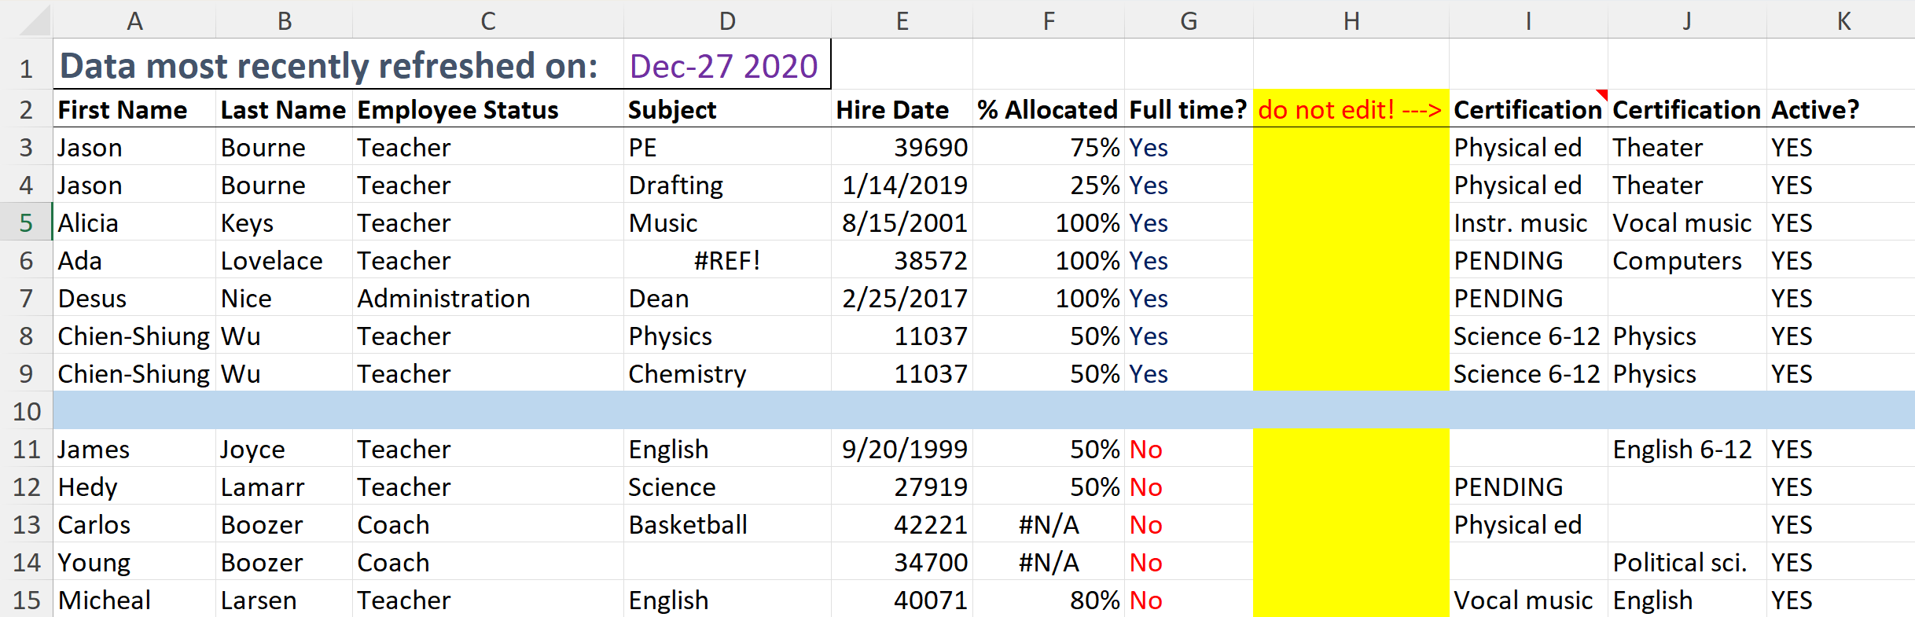
Cleaning With Janitor
Example of a roster of teachers from a fictional American high school; available at https://github.com/sfirke/janitor

Slide 5
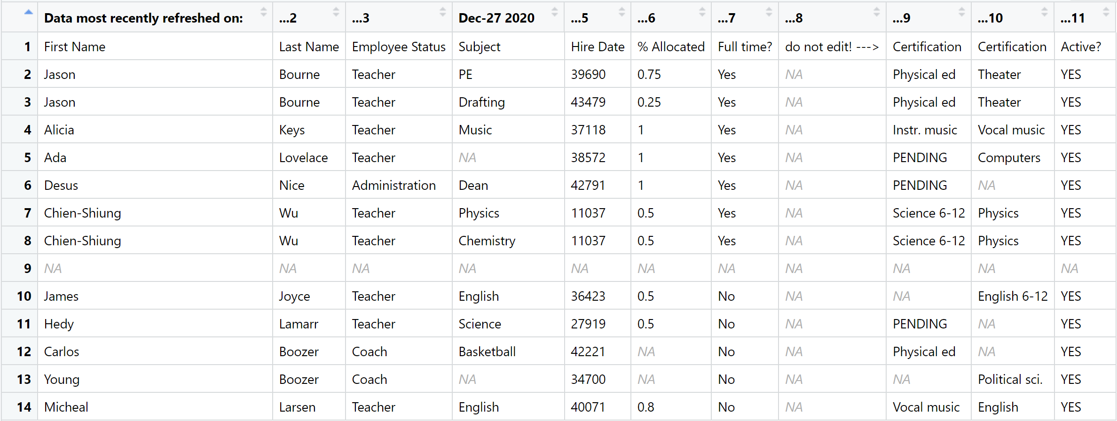
Cleaning With Janitor
Loading the data into R, there’s a lot of issues at the onset. But janitor will expedite the cleanup!

Slide 6
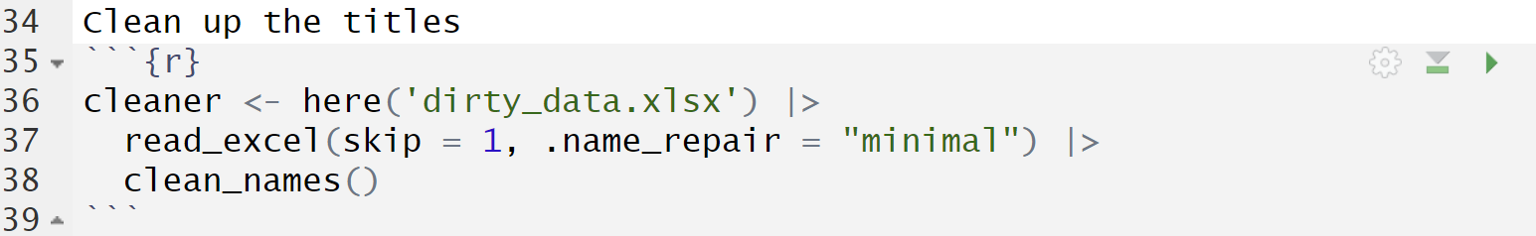
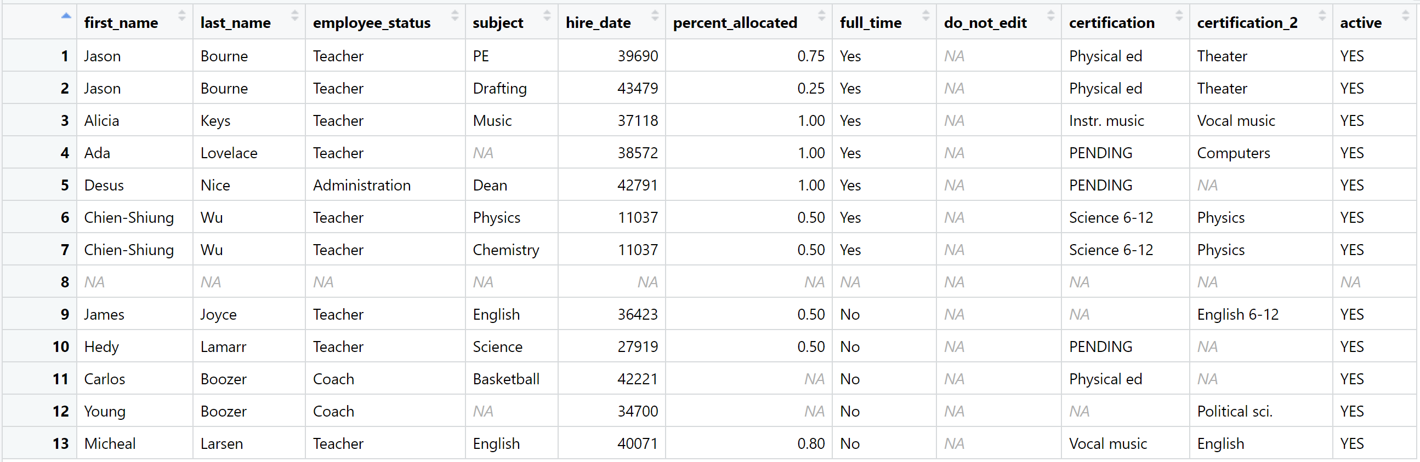
Function: clean_names()
Use the clean_names() function:
Standardizes column names, making them consistent and easier to work with. It converts names to snake_case and removes special characters.
Capitalization ➡️ lowercase typeface
Spacing ➡️ replaced with _
Irregular Characters (i.e. %, /) ➡️ replaced with word

Slide 7


Function: clean_names()
Use the clean_names() function:
Standardizes column names, making them consistent and easier to work with. It converts names to snake_case and removes special characters.
Capitalization ➡️ lowercase typeface
Spacing ➡️ replaced with _
Irregular Characters (i.e. %, /) ➡️ replaced with word

Slide 8
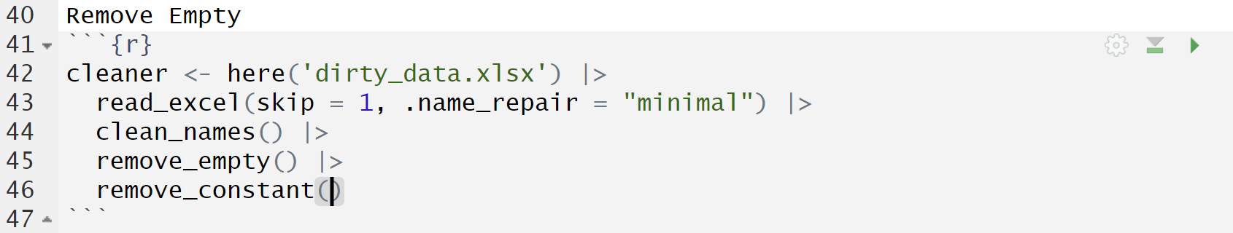
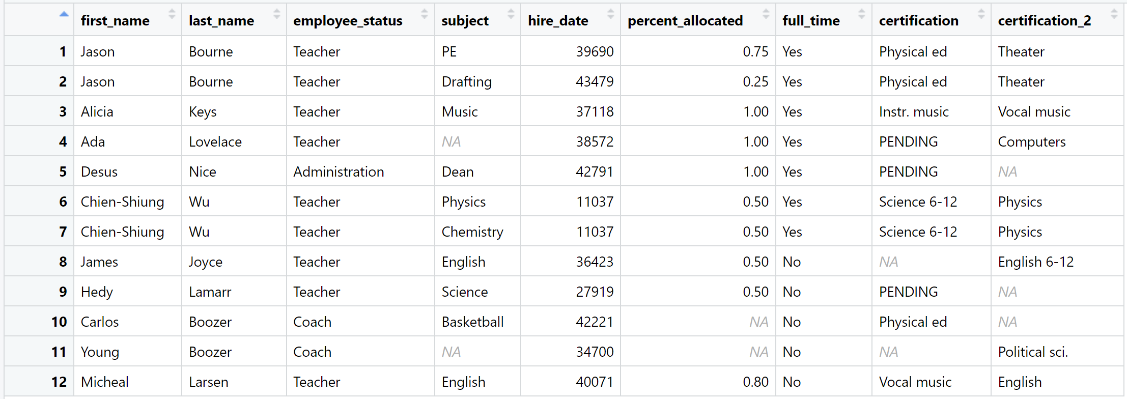
Function: remove_empty() & remove_constant()
Use the remove_empty() & remove_constant() functions:
Removed all empty rows and columns, and removed the ‘active’ column which only had values of ‘YES’
Function remove_empty() removes empty rows/columns from a data frame. Useful for cleaning up datasets with missing (NA) data.
Sinilarly, function remove_constant() removes rows/columns with a constant entry.

Slide 9

Function: remove_empty() & remove_constant()
Use the remove_empty() & remove_constant() functions:
Removed all empty rows and columns, and removed the ‘active’ column which only had values of ‘YES’
Function remove_empty() removes empty rows/columns from a data frame. Useful for cleaning up datasets with missing (NA) data.
Sinilarly, function remove_constant() removes rows/columns with a constant entry.

Slide 10
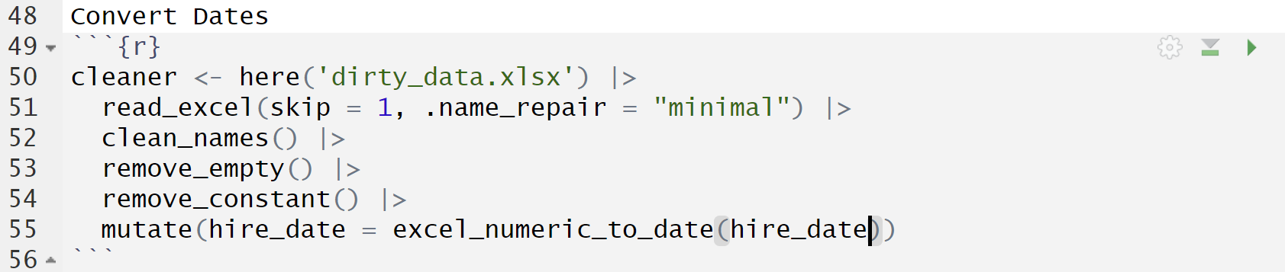
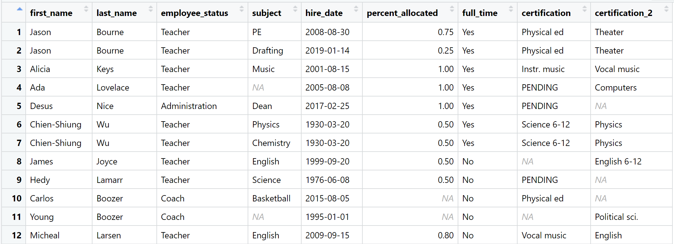
Function: excel_numeric_to_date()
Use the excel_numeric_to_date() function:
Replaced the excel numeric date format with R’s YYYY-MM-TT format
Converts numeric date formats used by Excel to actual R dates.

Slide 11
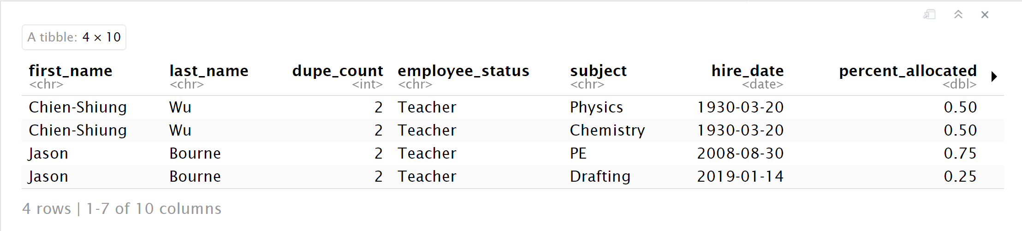
Function: get_dupes()
Use the get_dupes() function to tally number of duplicates:
Identifies duplicate rows in a data frame, showing them for easy inspection.
Can see that two of our teachers are repeated
Especially useful when working on large data frames!

Slide 12
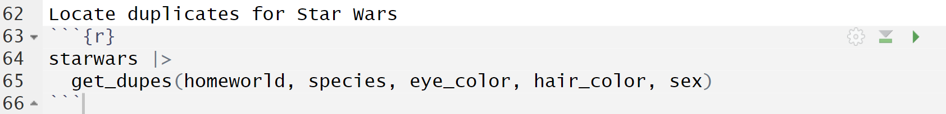
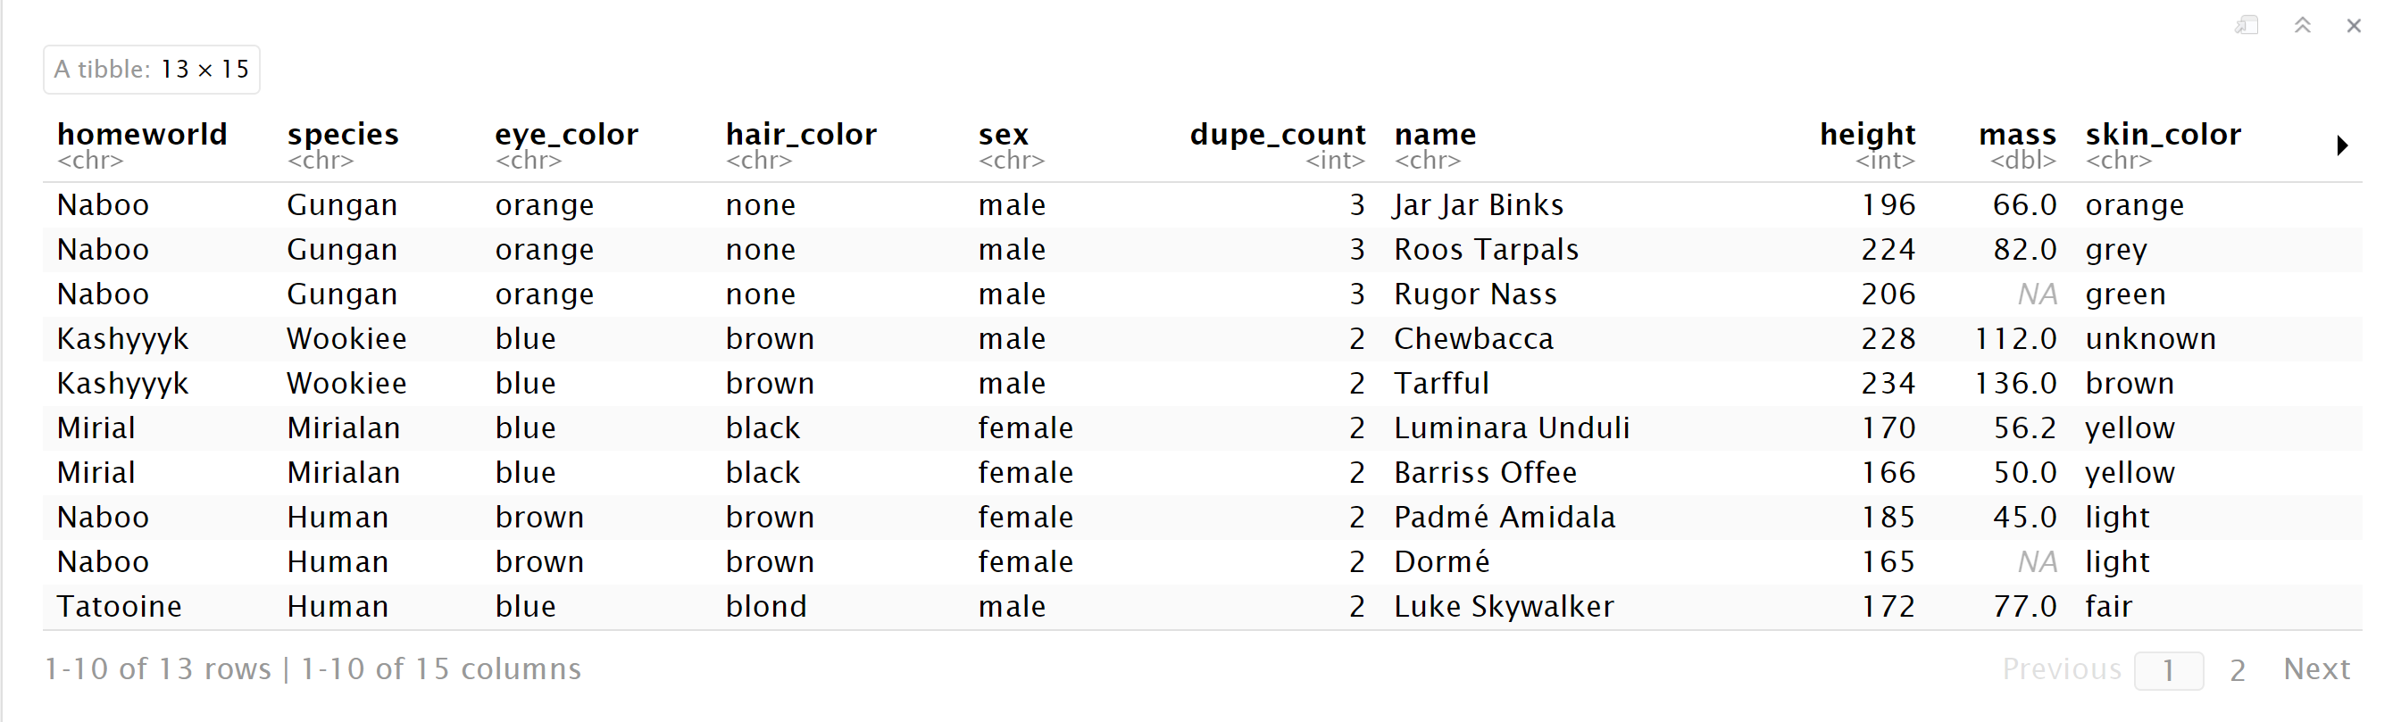
Function: get_dupes()
For the Star Wars data frame, use the get_dupes() function to tally number of duplicates for multiple variables:
Identifies duplicate rows in a data frame, showing them for easy inspection.
Based on the conditions for homeworld, species, eye color, hair color, and sex we can see all the matches in the data frame
Helpful Janitor function for exploring data!

Slide 13
Janitor’s tabyl Function & Data Analysis
tabyl provides a quick summary table for a data frame; It's great for counting and summarizing categorical variables
The Base R equivalent, Count, only works with data frames; tabyl works on vectors too when tabulating a single variable
tabyl(groceries$fruit)
Using tabyl on a data frame, can perform 1-way, 2-way, and 3-way counts of the data

Slide 14
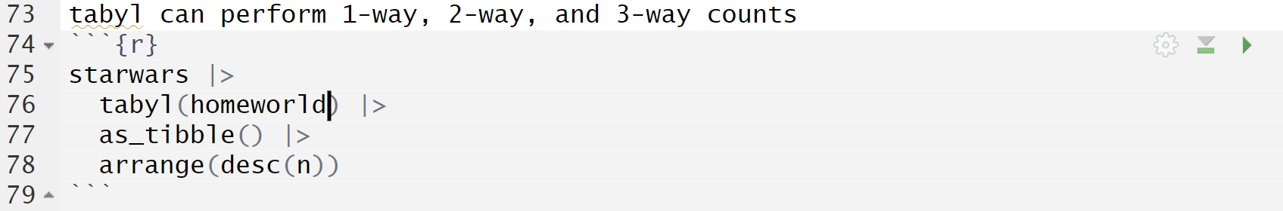
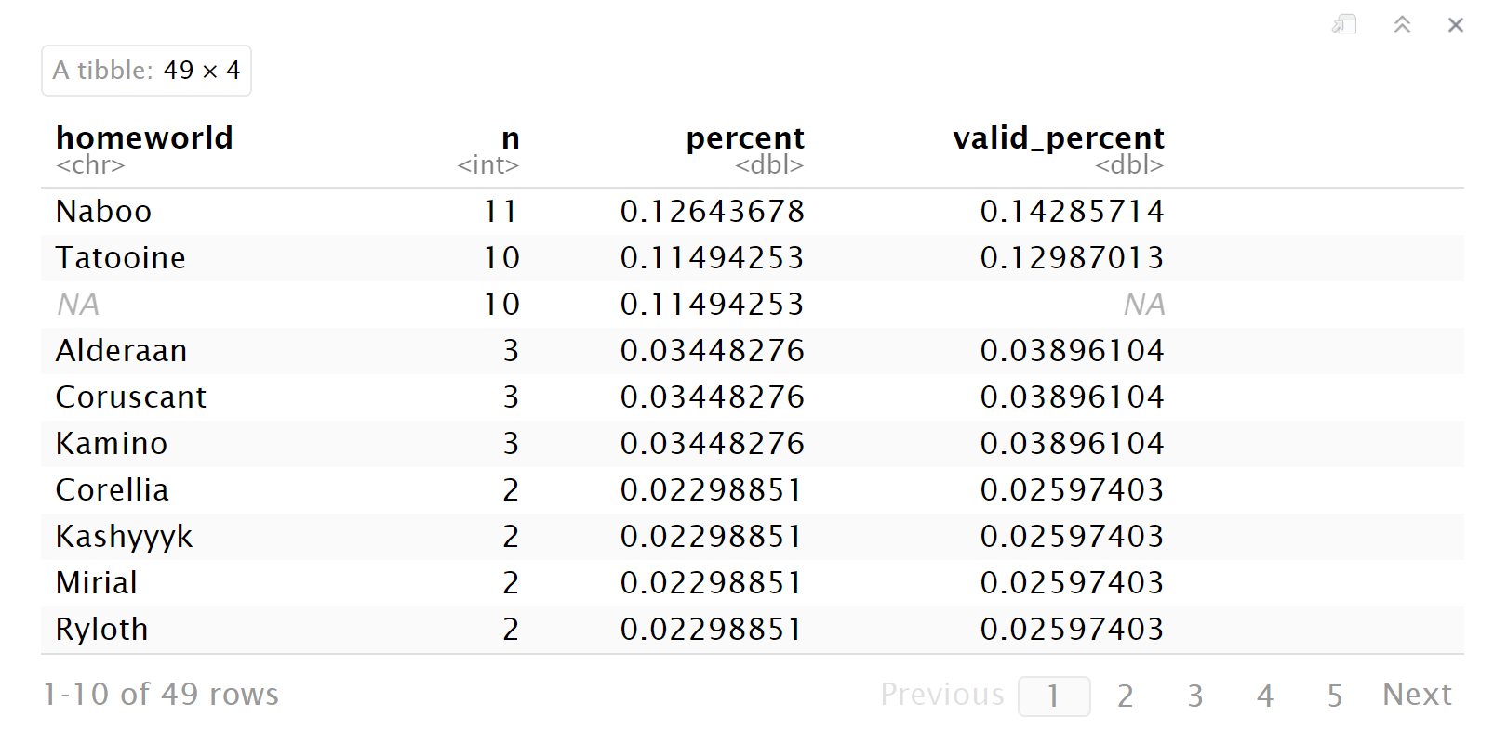
Function: tabyl()
For the Star Wars data frame, use the tabyl() function to perform a one-way test:
Creates frequency tables for a vector or a combination of variables in a data frame. It is useful for quickly summarizing categorical data and viewing counts and proportions.
Percent of frequency given for each planet

Slide 15
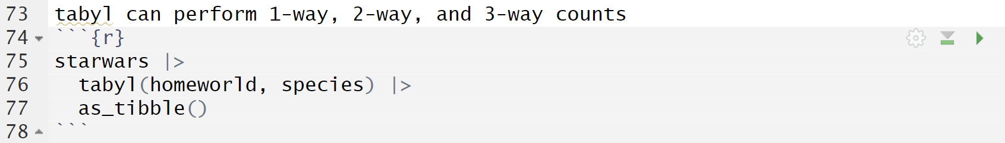
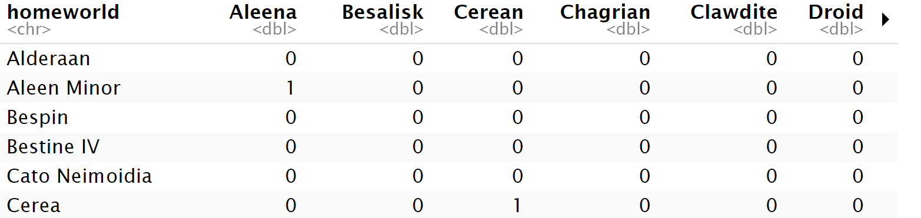
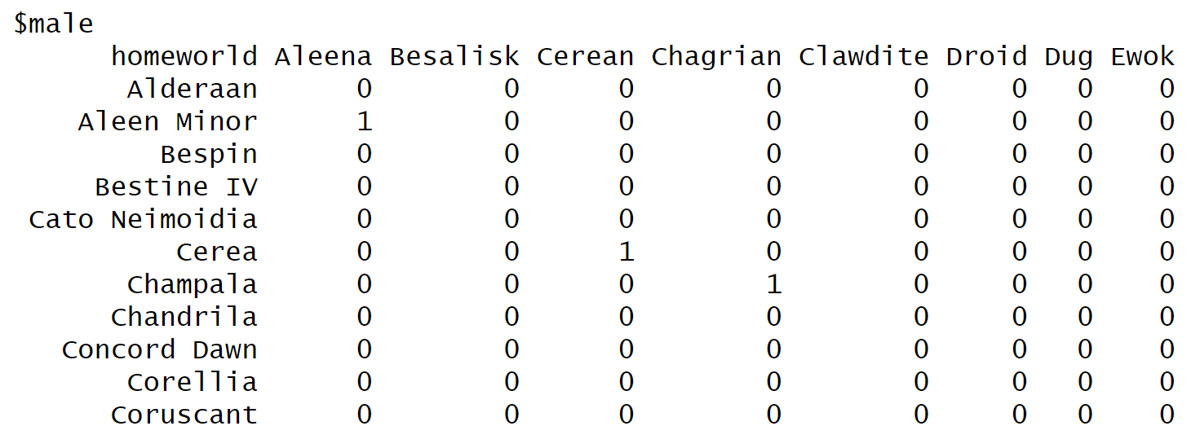
Function: tabyl()
Now perform a two-way test:
Creates frequency tables for a vector or a combination of variables in a data frame. It is useful for quickly summarizing categorical data and viewing counts and proportions.
…and a three-way test:

Slide 16
tabyl & adorn_ Functions
After generating a table with tabyl, you can further format it using the adorn_ set of functions
Some of the adorn_ functions include:
adorn_totals – Adds totals to a table, either row-wise, column-wise, or both.
adorn_percentages – Converts counts in a tabyl() output into proportions (percentages).
adorn_pct_formatting – Formats the percentages from decimals to percentage.
adorn_title – Adds a title to the tabyl (e.g., "Total", "Percent").

Slide 17
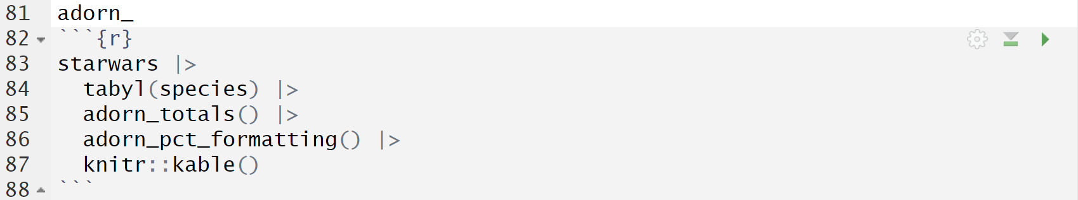
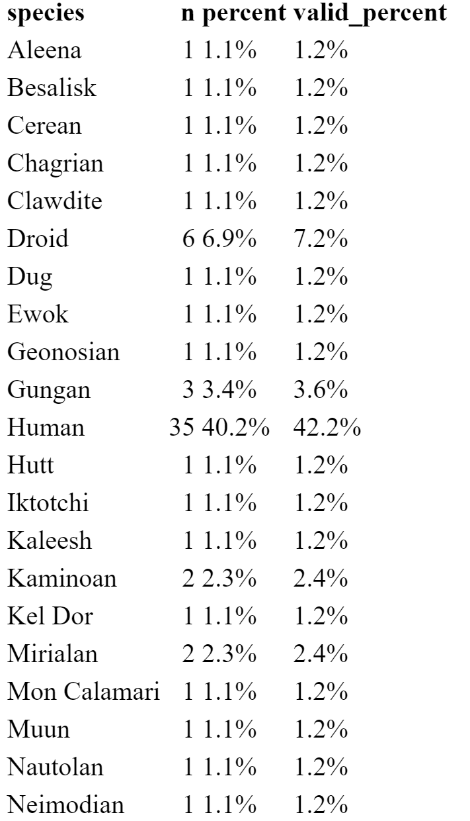
Function: tabyl() & adorn_
Use the tabyl() function in combination with adorn_ and kable():
Formats tabyl output into friendly and readable tables.

Slide 18
Conclusion
janitor is a user-friendly and powerful tool for examining and cleaning dirty data; it’s a multipurpose tool for data analysis that streamlines the data cleaning work, the foundation of every data analysis project.
tabyl excels in automatically computing proportions and producing tidy data frames that integrate seamlessly with the tidyverse ecosystem; the adorn_ functions can further enhance tabyl usefulness when generating informative frequency tables.
The janitor package has many other useful functions for data cleaning and exploration; those functions can be found here - https://sfirke.github.io/janitor/index.html

Slide 19

"Your move, chief."

Slide 20
Sources Cited
“Janitor Package - RDocumentation.” Accessed October 23, 2024. https://www.rdocumentation.org/packages/janitor/versions/2.2.0.
Sant, Gus Van. “Good Will Hunting - Apple TV (HU).” Apple TV, January 9, 1998. https://tv.apple.com/hu/movie/good-will-hunting/umc.cmc.ljmzio5szpnhca4ydns8f99q.
“Sfirke/Janitor: Simple Tools for Data Cleaning in R.” Accessed October 23, 2024. https://github.com/sfirke/janitor.
“Why Every Data Scientist Needs the Janitor Package.” Numbers around Us (blog), August 16, 2024. https://medium.com/number-around-us/why-every-data-scientist-needs-the-janitor-package-da37e4dcfe24.

